Slide 1

FPGA Alarm Project
By: Matthew McGary and Abd El Rahman Sidky

Slide 2
Alarm Clock Summary
Key features:
Real Time Clock Display
Current time adjustment
Visual alarm indication
Alarm Auto-shutoff
Alarm time adjust mode

Slide 3
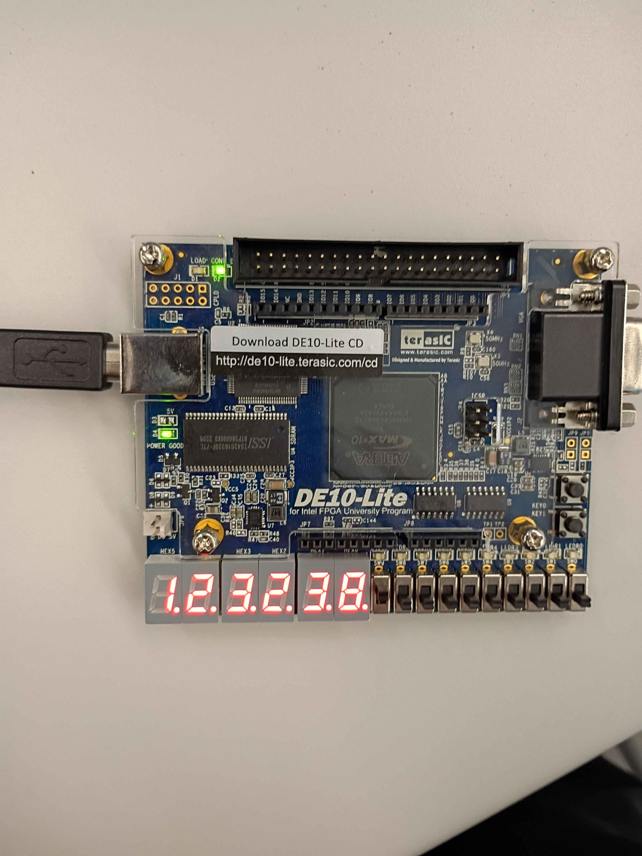
Critical Variables
En_D (27byt)
En_Q (27byt)
alarm_latch
Alarm_set_mode
Inc_key_Q ---> increase digit for adjust

Slide 4
The Alarm
The alarm feature is designed to have a condition where it would go off at 8:00:00.
The alarm is designed to go off for 20 seconds and then stop automatically or if the user wanted to turn the alarm off sooner, they could press key 0.
When the alarm goes off the LEDR display will flash on and off until the 20 seconds have passed or key 0 has been pressed.

Slide 5
Clock Logic
assign dec0_D = (!adjust_active && tick)?(dec0_Q == 9 ? 0 : dec0_Q + 1):
((sel_sec && inc_pulse && ~alarm_set_mode)? (dec0_Q == 9 ? 0 : dec0_Q + 1) :dec0_Q);
assign AlarmDec0_D = alarm_set_mode ? ((sel_sec && inc_pulse)? (AlarmDec0_Q == 9 ? 0 : AlarmDec0_Q + 1) :AlarmDec0_Q) : AlarmDec0_Q;
assign dec1_D = (!adjust_active && tick && (dec0_Q == 9)) ?
(dec1_Q == 5 ? 0 : dec1_Q + 1) :
((sel_sec && inc_pulse && ~alarm_set_mode && (dec0_Q == 9)) ? (dec1_Q == 5 ? 0 : dec1_Q + 1) :dec1_Q);
assign AlarmDec1_D = alarm_set_mode ? ((sel_sec && inc_pulse && (AlarmDec0_Q == 9)) ? (AlarmDec1_Q == 5 ? 0 : AlarmDec1_Q + 1) :AlarmDec1_Q) : AlarmDec1_Q;

Slide 6
Alarm Code
wire alarm;
assign alarm =
(dec5_Q == AlarmDec5_Q) &&
(dec4_Q == AlarmDec4_Q) &&
(dec3_Q == AlarmDec3_Q) &&
(dec2_Q == AlarmDec2_Q) &&
(dec1_Q == AlarmDec1_Q) &&
(dec0_Q == AlarmDec0_Q);
always @(posedge clock or posedge reset)
begin
if (reset) begin
alarm_latch <= 0;
alarm_timer <= 0;
end
else if (~KEY[0]) begin
alarm_latch <= 0;
alarm_timer <= 0;
end
else if (alarm) begin
alarm_latch <= 1;
alarm_timer <= 20;
end
else if (alarm_latch && tick1) begin
if (alarm_timer > 0)
alarm_timer <= alarm_timer -1;
else
alarm_latch <= 0;
end
end

Slide 7
Team Contributions
Sidky:
Designed the tick counter
Created the ability to set the clock
Design the code for the 7-segment display
Matthew:
Set up the alarm
Set up the alarm latch to deactivate alarm
Created the code to deliver the time

